Slide 1
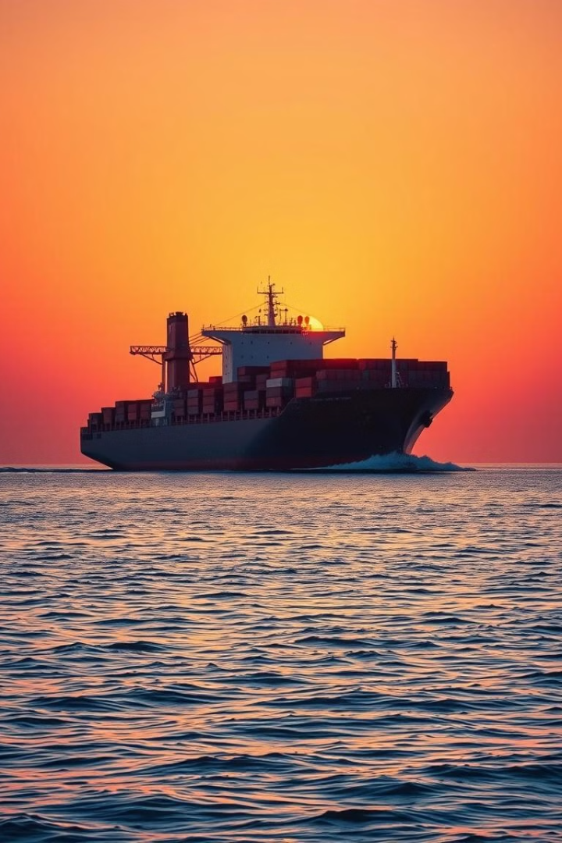
🌊 Global Maritime & Logistics
My expertise lies in building strong business connections and fostering relationships that create opportunities.

Slide 2
Connecting Businesses Across Continents
Global Reach
Seamless Solutions
Leveraging a network of trusted partners worldwide
Streamlined logistics, door-to-door delivery

Slide 3
Tailored Solutions for Your Needs
Import-Export Services
Freight Forwarding
Managing complex customs procedures
Secure and efficient transportation by sea, land, or air
Warehousing & Distribution
Safe and secure storage and distribution

Slide 4
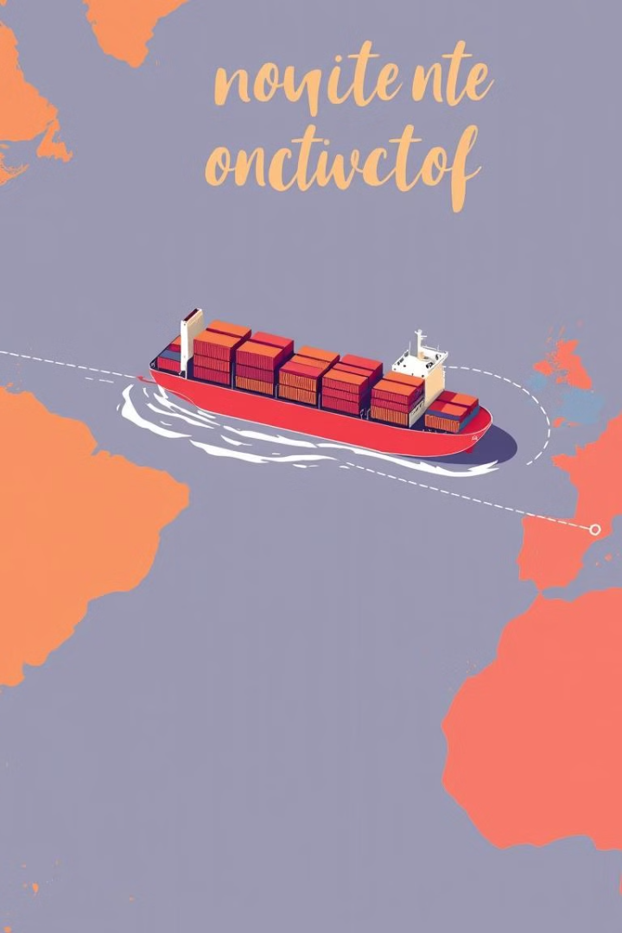
Seamless Cargo Management
1
Order Processing
Real-time tracking and updates
2
Shipping & Transit
Ensuring timely delivery
3
Customs Clearance
Streamlined customs procedures

Slide 5
Building Long-Term Partnerships
1
Transparent communication
2
Reliable service delivery
3
Competitive pricing

Slide 6
Leveraging Technology for Efficiency
Online platforms for real-time tracking
Automated customs clearance
Smart contracts for secure transactions

Slide 7
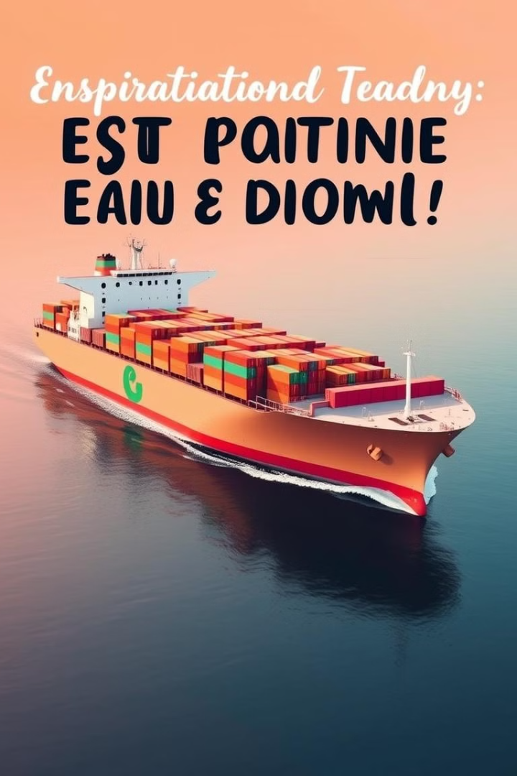
Focus on Sustainability
Reduced emissions
Optimized routes
Sustainable packaging

Slide 8
Global Maritime & Logistics: Your Partner in Success
Contact us today to discuss your maritime and logistics needs. We look forward to building a strong and lasting partnership with you.

